Slide 1


BRIGHT
BRIGHT
COFFEE SHOP

Slide 2


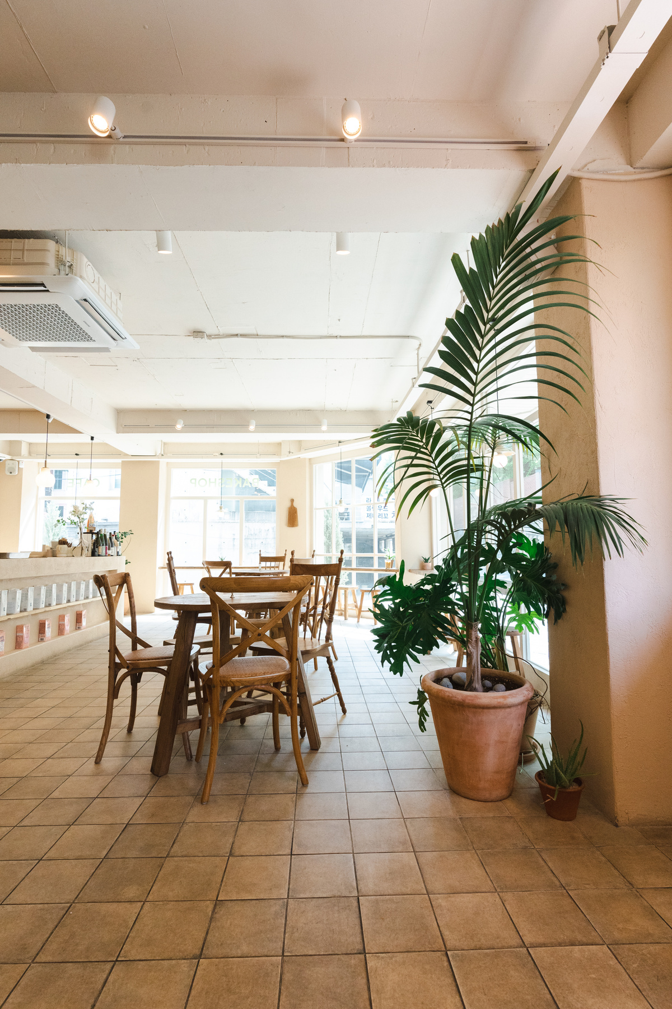
BRIGHT
Contents
Contents page
Introduction
Data systems
Analysis
Recommendation
Implementation plan
01

Slide 3
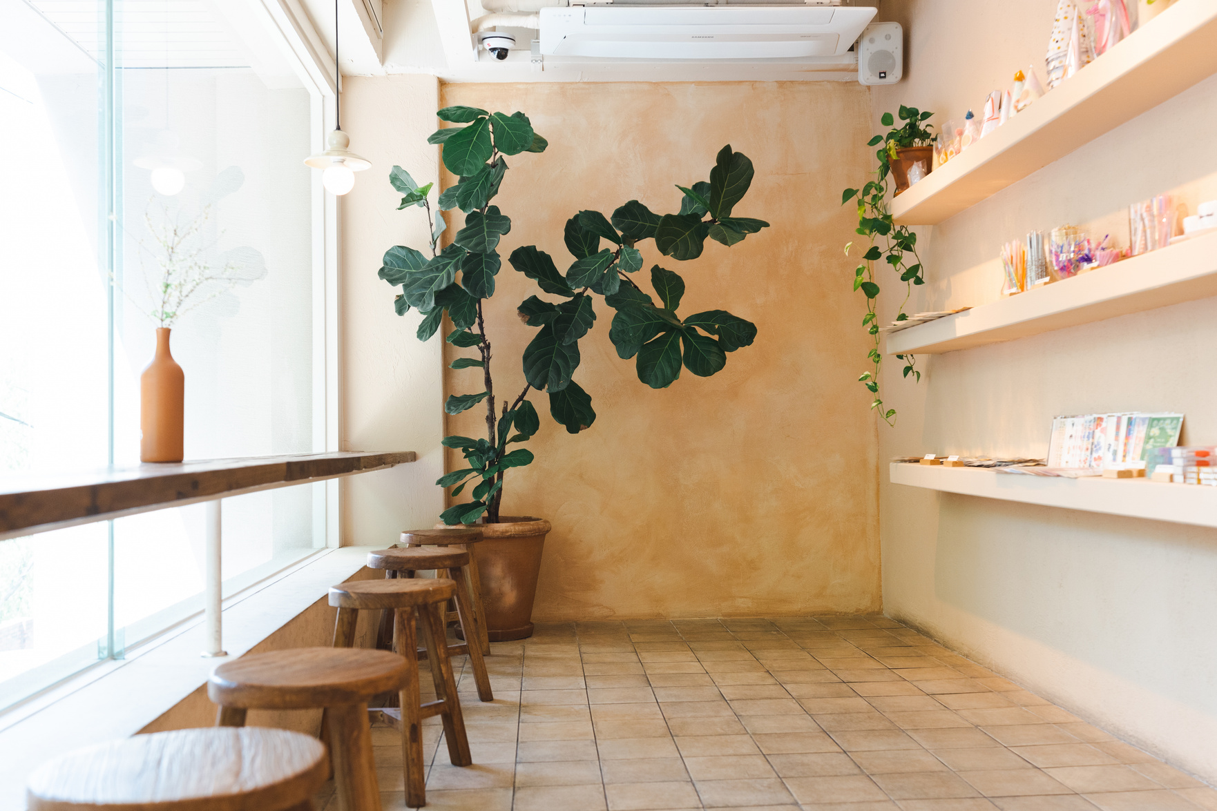

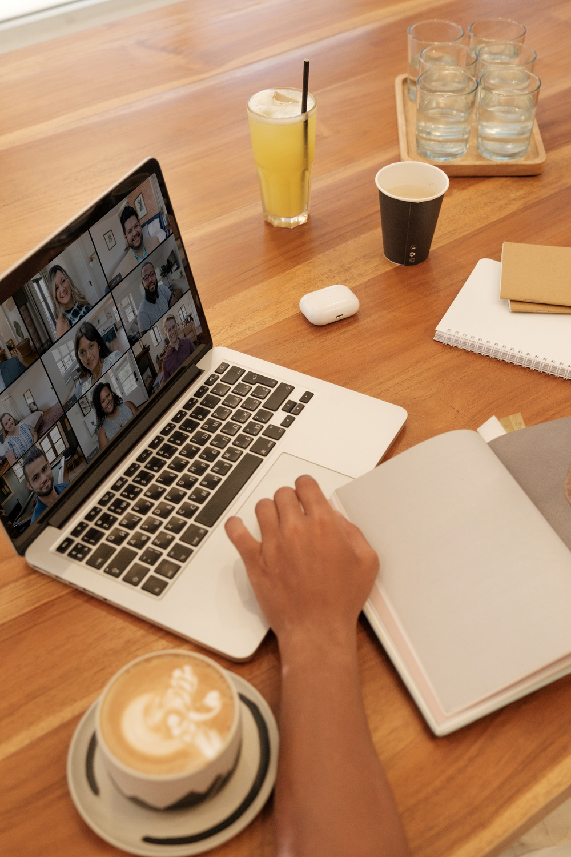
BRIGHT
INTRODUCTION
This report is based on an analysis done for Bright Coffee which has 3 distinct locations namely: Lower Manhattan, Hell’s Kitchen and Astoria. The purpose of the report is to assist the coming in CEO to make informed decisions based on the sales trends and revenue. At the end of the presentation there will also be recommendations provided.
02

Slide 4

BRIGHT
INSIGHTS: THE FOLLOWING DATA SYSTEMS WERE USED TO COMPILE THIS REPORT.
Data systems
SQL
Databricks
Excel
Raw data(CSV)
03

Slide 5
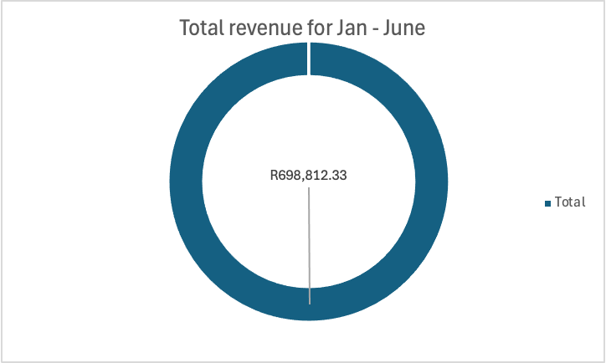
THIS IS THE TOTAL REVENUE ACCUMULATED BY BRIGHT COFFEE FOR THE ANALYSIS PERIOD JAN - JUNE.
BRIGHT
ANALYSIS
04

Slide 6
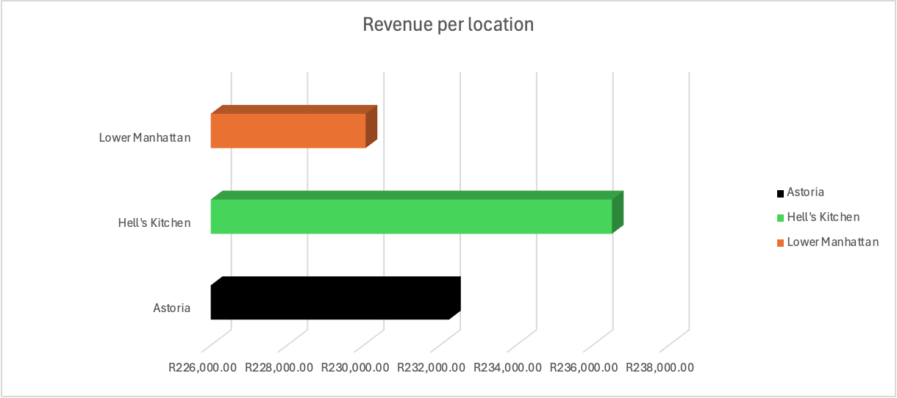
BRIGHT
INSIGHTS: THE BAR GRAPH BELOW SHOWS THE REVENUE BASED ON THE 3 DIFFERENT STORE LOCATIONS.
05

Slide 7
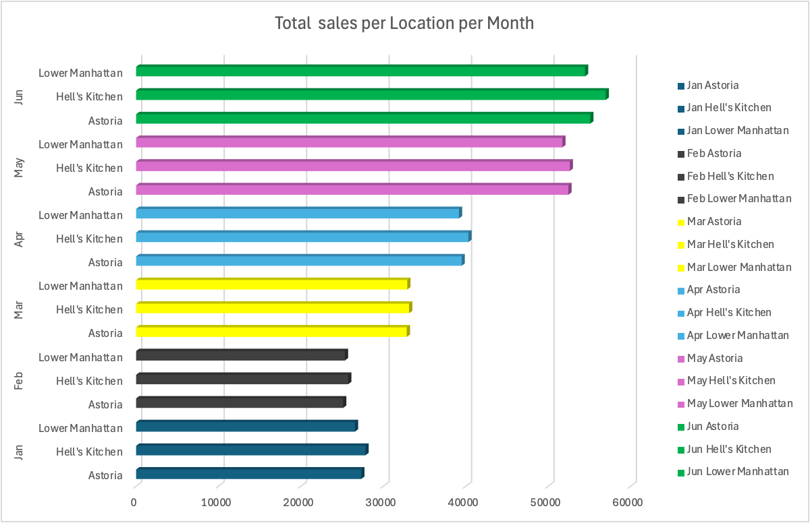
BRIGHT
INSIGHTS: THE GRAPH BELOW BREAKS DOWN REVENUE FOR EACH STORE LOCATION EACH MONTH.
IT SHOWS THAT BRIGHT COFFEE GENERATED MORE REVENUE IN COLDER MONTHS.
05

Slide 8

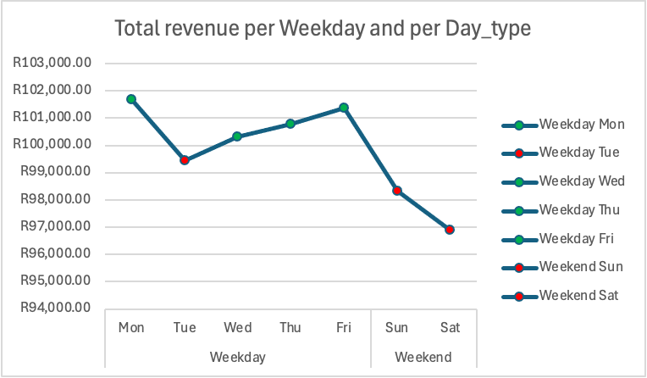
BRIGHT
INSIGHTS: GRAPH BELOW IS THE TOTAL REVENUE PER DAY OF WEEK.
THIS IS SHOWING THAT THE OVERALL SALES TEND TO DECLINE OVER THE WEEKEND.

Slide 9
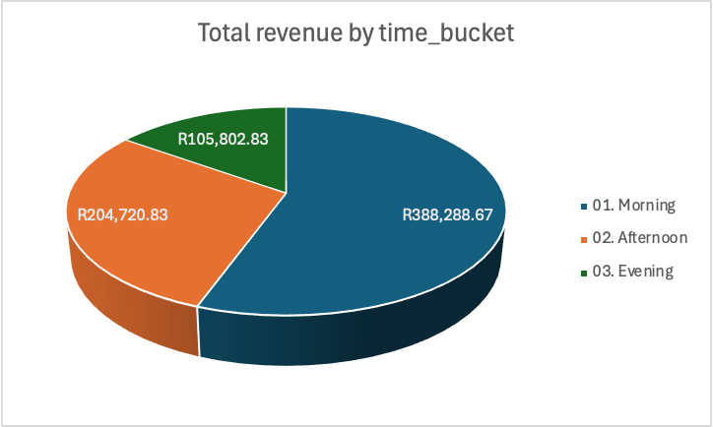
BRIGHT
INSIGHTS: THIS GRAPH DISPLAYS THE DIFFERENT TIME BUCKETS: MORNING, AFTERNOON AND NIGHT.
BRIGHT COFFEE GENERATES MOST OF ITS REVENUE IN THE MORNING.

Slide 10

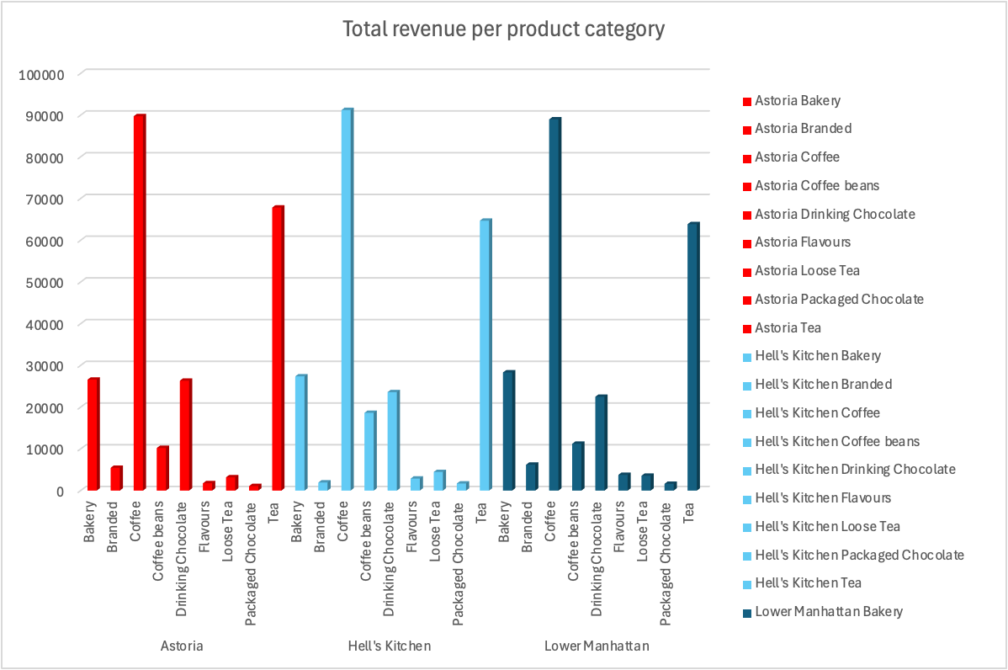
BRIGHT
INSIGHTS: REVENUE PER PRODUCT CATEGORY.
THE GRAPH SHOWS THAT COFFEE IS THE MOST BOUGHT BEVERAGE ACROSS ALL 3 LOCATIONS.

Slide 11
Recommendation
-Prioritize buidling customer loyalty through rewards programs. i.e. Giving a customer a free cup of coffee after a certain number of purchases
-Boost visibility in low performing locations by having random pop-up stores
-Create a working space/social hub where customers may utilize your space for a quick on the go meeting.
-Include a delivery service / Mobile coffee barista to ensure that the customer’s order preserves its quality.

